Slide 1

Course Project 6: Reinforcement Learning
Hands on Artificial Intelligence and Robotics
Lingxiao Wang, Ph.D.
Assistant Professor of Electrical Engineering
Louisiana Tech University

Slide 2
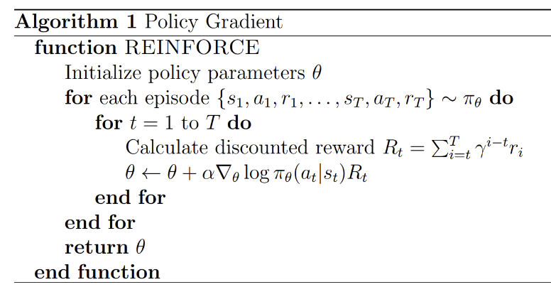
Task Introduction
In this project, we will learn to implement two main deep reinforcement learning methods:
Policy Gradient
Actor-critic
The environment of this project is Lunar Lander (link)
Your task is to control a rocket landing on a the moon’s surface (rough terrain)
Policy Gradient:

Slide 3
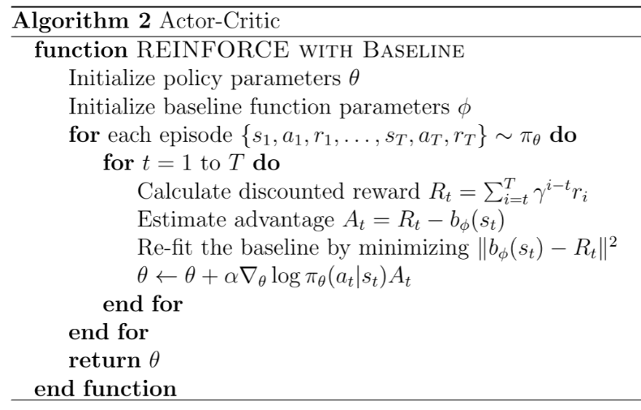
Task Introduction
Actor-Critic

Slide 4
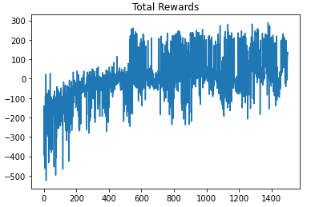
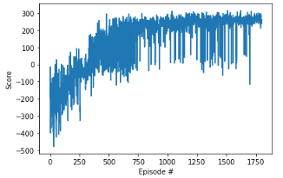
Sample Result

Slide 5
Grading Policy
Averaged Reward on Testing | Hint | Grade
<0 | Run sample code | 80
0 ~ 199 | Increase the training episodes Use Discounted Total reward instead of Immediate reward | 90
199~299 | Use Advantage Actor-Critic | 100

Slide 6
Sample Code
https://colab.research.google.com/drive/1wRmqMTwvNb5MTDdza2QntIS6TeLpUQBb?usp=sharing

